Slide 1


What is CSS?
CSS stands for Cascading Style Sheets. It's a fundamental language used to style web pages and control the visual presentation of elements on a website. CSS allows you to dictate how elements should look, including their colors, fonts, sizes, spacing, and layout. Think of CSS as the makeup and clothing for your website – it's what gives it its unique look and feel.

Slide 2

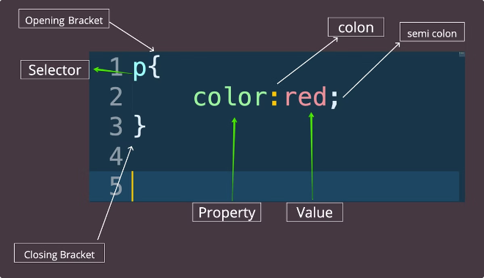
CSS Syntax
CSS syntax follows a specific format, which involves defining rules that govern how elements should be styled. Each rule consists of a selector, which identifies the element to be styled, and a declaration block, which contains one or more property-value pairs. The selector is followed by curly braces {}, within which you define the styling properties and their corresponding values. For example, to change the background color of a paragraph element to blue, you would write:
p { background-color: blue; }
1
Selector
2
Declaration Block
The selector specifies the HTML element or elements you want to style. You can use various types of selectors to target specific elements, such as element selectors (p, h1, div), class selectors (.myClass), and ID selectors (#myId).
The declaration block contains the styling properties and their values. Each property-value pair is separated by a colon (:), and each declaration is separated by a semicolon (;). For example,
color: red;
sets the color property to red.

Slide 3
How to use CSS
There are three main ways to use CSS, each with its own purpose and method of implementation. These types are:
Inline CSS
Internal CSS
External CSS
Inline CSS is applied directly within the HTML element itself using the style attribute. For instance:
Internal CSS is defined within the <style> tag, which is placed within the <head> section of your HTML document. This allows you to centralize styling for the entire page. For example:
External CSS is stored in a separate file with the .css extension, which is linked to your HTML document using the <link> tag. For example:
<p style="color: green;">This paragraph has green text.</p>
<link rel="stylesheet" href="styles.css" >
<style> p { color: blue; } </style>
This approach is best for larger projects or when you need to apply the same styles to multiple pages, as it improves code organization and maintainability.
Inline CSS is useful for applying styles to individual elements, but can become unwieldy if you need to apply the same styles to multiple elements.
Inline styles are often used for specific, one-off styling adjustments, but they can make your code less maintainable and organized in the long run.
Internal styles are suitable for smaller projects or for applying styles to elements on a specific page.

Slide 4

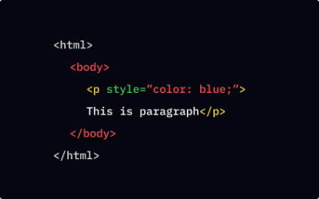
Inline CSS
Inline CSS is applied directly within the HTML element using the style attribute. This method offers a simple way to style individual elements with minimal code, but it has limitations. Here's a breakdown:
Advantages
Disadvantages
When to Use
Inline CSS is easy to use, especially for single instances of specific styling. It doesn't require any separate CSS files.
Inline styles can make your HTML code cluttered and difficult to maintain, especially for larger projects. It's challenging to reuse styles across multiple elements. Additionally, inline styles can lead to a lack of consistency in styling throughout your website.
Inline CSS is best suited for quick, specific styling changes or when you need to apply a unique style to a single element, like a button or an image, without impacting other elements.

Slide 5

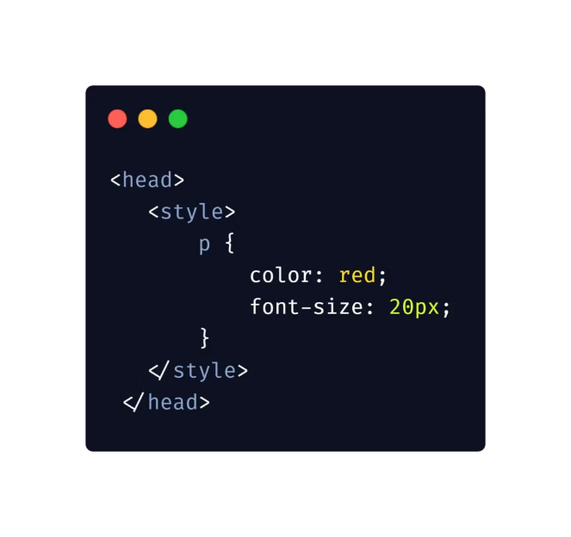
Internal CSS
Internal CSS is defined within the <style> tag, which is placed within the <head> section of your HTML document. This approach allows you to centralize styling rules for a single HTML page. Let's explore its key aspects:
Advantages
Centralized styling for the entire page. More organized and maintainable than inline CSS. Can easily be reused across different elements within the same HTML document.
Disadvantages
Limited to the HTML document it's placed in. Styling rules are not reusable across multiple HTML documents. Makes it harder to manage styles across a website when it grows in size.
When to Use
Internal CSS is well-suited for smaller projects where styling needs are confined to a single page. It offers a good balance between code organization and maintainability while keeping styling within the context of a specific page.

Slide 6

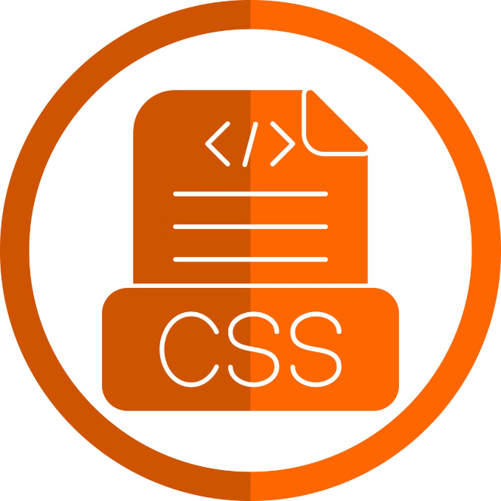



External CSS
External CSS is the most common and recommended approach to styling websites, especially for larger projects. It involves creating separate CSS files with the .css extension and linking them to your HTML document using the <link> tag. Let's delve into its benefits and considerations:
Advantages
Provides maximum organization and maintainability. Enables easy reuse of styles across multiple HTML documents within your website. Promotes code reusability, making updates and changes easier. Facilitates collaboration by allowing multiple developers to work on different CSS files.
Disadvantages
Requires additional files to manage. Slightly more complex to set up compared to inline and internal CSS. Can introduce an additional HTTP request, potentially impacting page load times, although this is usually negligible.
When to Use
External CSS is the preferred approach for most website development. It promotes code reusability, organization, and ease of maintenance, especially for large websites with many pages and complex styling requirements.

Slide 7

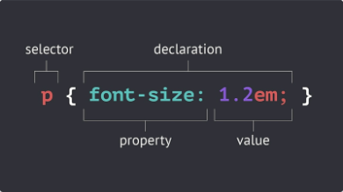




CSS Selectors
CSS selectors are crucial for identifying the specific elements you want to style. They act as pointers, allowing you to target elements based on their tags, classes, IDs, or other characteristics. Here are some common types of selectors:
Element Selectors
Class Selectors
ID Selectors
Descendant Selectors
Target all elements with a specific tag name, such as p (for paragraphs), h1 (for headings), or div (for divisions). For example
Target elements that have a specific class attribute assigned to them. Classes are often used to group similar elements together for styling. For example, .myClass { background-color: red; } styles all elements with the class "myClass" to have a red background.
Target a single element that has a specific ID attribute. IDs are unique identifiers for specific elements and are usually used for targeting specific elements that require unique styling. For example, #myElement { font-size: 20px; } styles the element with the ID "myElement" to have a font size of 20 pixels.
Target elements that are descendants of another element. For example, div p { color: green; } styles all paragraph elements that are direct descendants of a div element to have a green color.
p{
color : "blue";
}
styles all paragraph elements to blue.

Slide 8

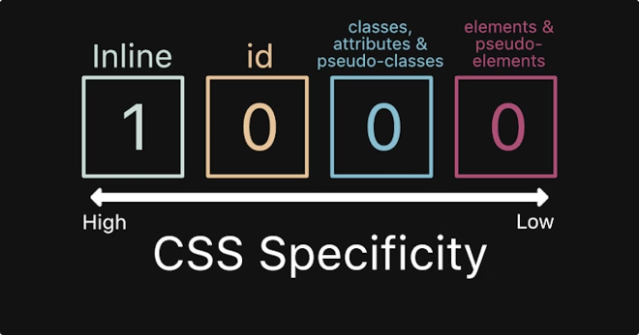
CSS Specificity
CSS specificity determines which CSS rule applies to an element when multiple rules are defined for the same element. The more specific the rule, the higher its priority, meaning it overrides less specific rules. Let's explore how specificity works:
1
Inline Styles
Inline styles, applied directly to elements, have the highest specificity.
2
ID Selectors
ID selectors have high specificity, as they target unique elements.
3
Class Selectors
Class selectors have lower specificity than ID selectors, but higher than element selectors.
4
Element Selectors
Element selectors have the lowest specificity, as they target all elements with the same tag name.

Slide 9


Applying CSS
Once you understand CSS syntax and selectors, applying styles to your website is straightforward. The key is to use the right selectors to target the specific elements you want to style. Let's look at a practical example:
<style> h1 { /* Element selector */ color: red; font-size: 32px; } .myClass { /* Class selector */ background-color: blue; padding: 10px; } #myId { /* ID selector */ text-align: center; } </style>
This code styles all h1 elements with red text and a font size of 32px, all elements with the class "myClass" with a blue background and 10px padding, and the element with the ID "myId" to have its content centered.

Slide 10


CSS Selectors:
CSS Selectors are the foundation of styling web pages. They allow you to target specific elements within your HTML document and apply styles to them. Think of CSS Selectors as the address book for your webpage's style, letting you pinpoint exactly what you want to modify.

Slide 11
Type Selectors
Type Selectors are the simplest form of CSS Selectors. They target HTML elements based on their tag name. For example, the selector `h1` will target all "h1 elements" on the html file.
h1{
color: red;
}
h1: Targets all level 1 headings
p: Targets all paragraph elements
div: Targets all division elements
a: Targets all anchor elements (links)
li: Targets all list items
Type Selectors are a great way to apply basic styles to your web pages. They're straightforward and easy to use, making them ideal for setting default styles and ensuring consistency across your website.

Slide 12
Class Selectors
Class Selectors allow you to group elements together and apply the same styles to all of them. This is done by adding a class attribute to your HTML element and then using the class name in your CSS selector.
Syntax
Example
Benefits
The syntax for a Class Selector starts with a dot (.) followed by the class name. For example:
To apply a specific style to all elements with the class "highlight," you would use the following CSS rule:
Class Selectors allow you to apply styles to specific sets of elements, making your CSS more organized and reusable. You can easily reuse the same class name across different elements on your webpage.
.class_name
.class1{
color:green;
}

Slide 13


ID Selectors
ID Selectors target a specific element on your page based on its unique ID. This is similar to Class Selectors, but IDs are designed to be used only once per document.
Example
Syntax
To apply a specific style to the element with the ID "main-header," you would use the following CSS rule:
The syntax for an ID Selector starts with a hash symbol (#) followed by the ID name. For example:
#main-header {
background-color: #f0f0f0;
padding: 20px;
}
#id_name
Benefits
ID Selectors allow you to precisely target a single element on your webpage. This is useful for applying unique styles to specific elements, such as headers or navigation bars.

Slide 14



Universal Selector
The Universal Selector targets all elements on your page. It is often used in conjunction with other selectors to apply styles to a wide range of elements, making your CSS more concise.
Example
To apply a default font to all elements on your page, you would use the following CSS rule:
* {
font-family: Arial, sans-serif;
}
Syntax
The Universal Selector is represented by an asterisk (*) symbol.
Benefits
The Universal Selector provides a quick way to apply styles to all elements on your page. It is particularly useful for setting default styles for your web pages.

Slide 15
CSS Properties and Their Syntax
CSS properties are the specific styles you apply to your web pages. They control various aspects of your elements, such as their color, font size, position, and more.
1
Background
The `background` property controls the background of an element. It can be set to a color, image, or gradient. For example:
background-color: #f0f0f0;
background-image: url('image.jpg');
background-repeat: no-repeat;
2
Color
The `color` property controls the color of text within an element. It can be set to a color name, hexadecimal value, or RGB value. For example:
color: blue;
color: #0000ff;
color: rgb(0, 0, 255);
3
Font
The `font` property controls the font used for text within an element. It can be set to a font family name, font size, font weight, and font style. For example:
font-family: Arial, sans-serif;
font-size: 16px;
font-weight: bold;
font-style: italic;
4
Margin & Padding
The `margin` property controls the space around an element, while the `padding` property controls the space within an element. They can be set to a fixed value or percentage. For example:
margin: 10px;
padding: 20px;
5
Position
The `position` property controls how an element is positioned on the page. It can be set to `static`, `relative`, `absolute`, or `fixed`. For example:
position: relative;
position: absolute;
position: fixed;
6
Border
The `border` property controls the border of an element. It can be set to a color, width, and style. For example:
border: 1px solid black;
border-radius: 5px;

Slide 16
Pseudo-classes & Pseudo-elements
Pseudo-classes and pseudo-elements allow you to target specific states of an element or create new elements within your CSS. This expands your ability to style elements in more dynamic ways.
Pseudo-classes
Pseudo-classes target specific states of an element, such as when it is hovered over, clicked, or focused. They are used to apply different styles to elements based on their current state. For example:
a:hover {
color : red;
}
Pseudo-elements
Pseudo-elements allow you to create new elements within your CSS. They are used to style parts of an element or add additional content. For example:
p::first-letter {
font-size: 2em;
font-weight: bold;
}

Slide 17
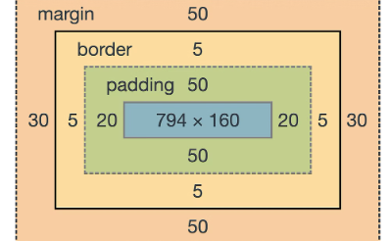
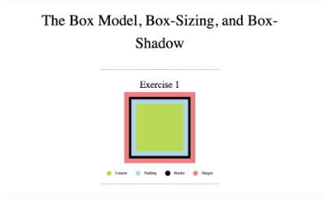
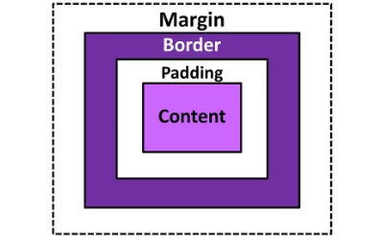

Box Model
The CSS Box Model is a fundamental concept that underpins the layout of web pages. It represents every HTML element as a rectangular box, defining its dimensions and how it interacts with other elements. The box model consists of four main components:
Content
Padding
Border
Margin
The actual content of the element, such as text or images.
The space between the content and the border. It affects the element's overall size.
The visible outline surrounding the content and padding. It adds visual structure to the element.
The space between the element's border and the surrounding elements. It controls the element's spacing from other elements.

Slide 18


Practice Makes Perfect
The best way to learn HTML, CSS is to practice. Experiment with different selectors, properties, and values.

